Slide 1
Observing the Effects of AI-Assistance in a Contract Analysis Workflow - A Case Study
May 13, 2024, Bachelor’s Thesis Kick-off Presentation
Anita Feigl

Slide 2
Outline
Background & Motivation
Research Questions
Methodology
Initial Findings
Timeline

Slide 3
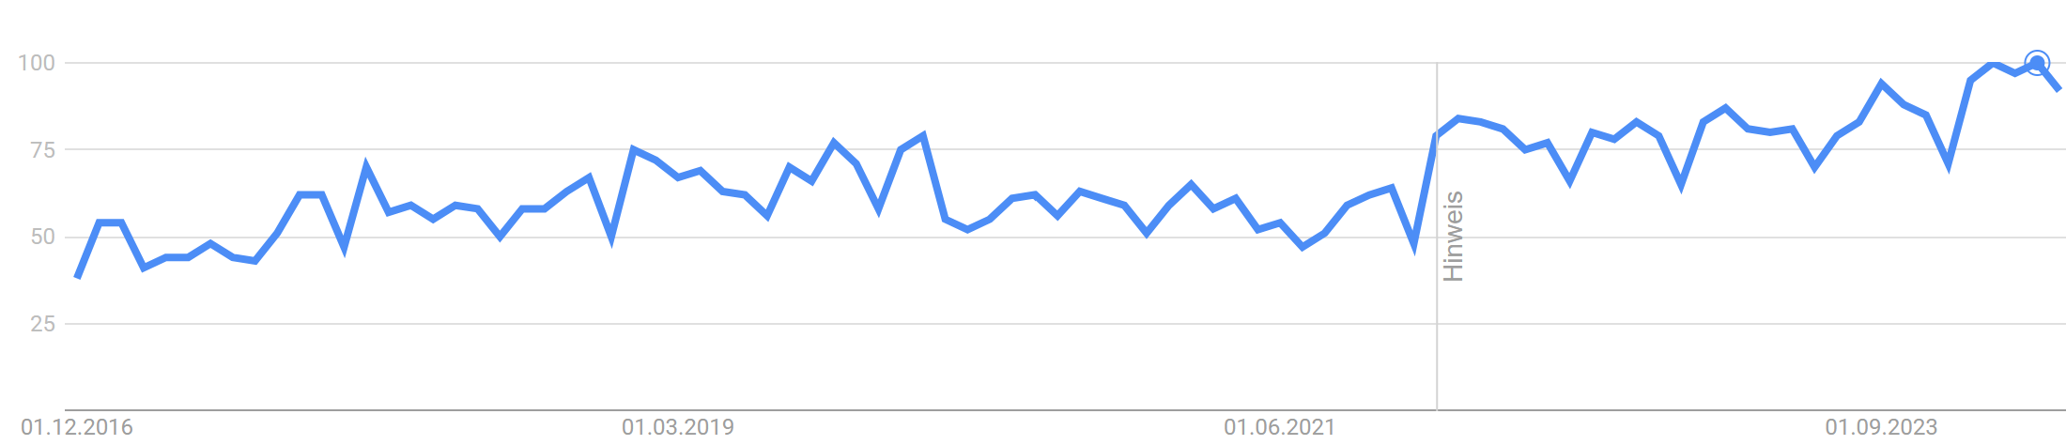
Background & Motivation
Google Trend „Legal Tech“
Search interest relative to the highest interest in the given frame
time
„63%
of surveyed legal leaders planning to accelerate legal tech investments”
[1] Gartner (2021)
Notes:
Chart:
Worldwide google trend of term “Legal Tech”
X-Axis: Time beginning in the end of 2016 till now
Y-Axis: the search interest relative to the highest point on the chart for the selected frame
Shows popularity over time
A value of 100 represents the highest popularity of this search term.
A value of 50 means the term is half as popular, and a value of 0 means there was not enough data for this term.
Hinweis=improvement of data collection system

Slide 4
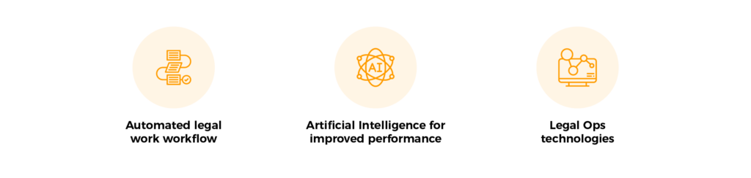
Background & Motivation
Top 3 Legal Tech Trends
[2] Adapted from ascendixtech (2023)
“Over the next two to five years, large language models (LLMs) will boost legal department productivity by at least 10% to 20%”
[3] Gartner (2024)
Notes:
Automated legal work workflow = automated legal services
AI for improved performance = Usage of AI in the Legal sector
Legal Ops technologies = technologies to improve internal operations , Management, Kommunication, planning

Slide 5
Background & Motivation
KIBeKodA: AI-Assisted Legal Analysis and Correction of German Emplyoyment Contracts
Objectives
AI assistance for the legal assessment and correction of employment contracts
Demonstrate feasibility of using LLMs to analyze german emplyment contracts
Blueprint for future use of AI in practice in the legal field
Support the adoption of digital technologies within the legal industry
design, implement and evaluate the system
Notes:
AI-assistence for the analysis and correction of enployment contracts

Slide 6
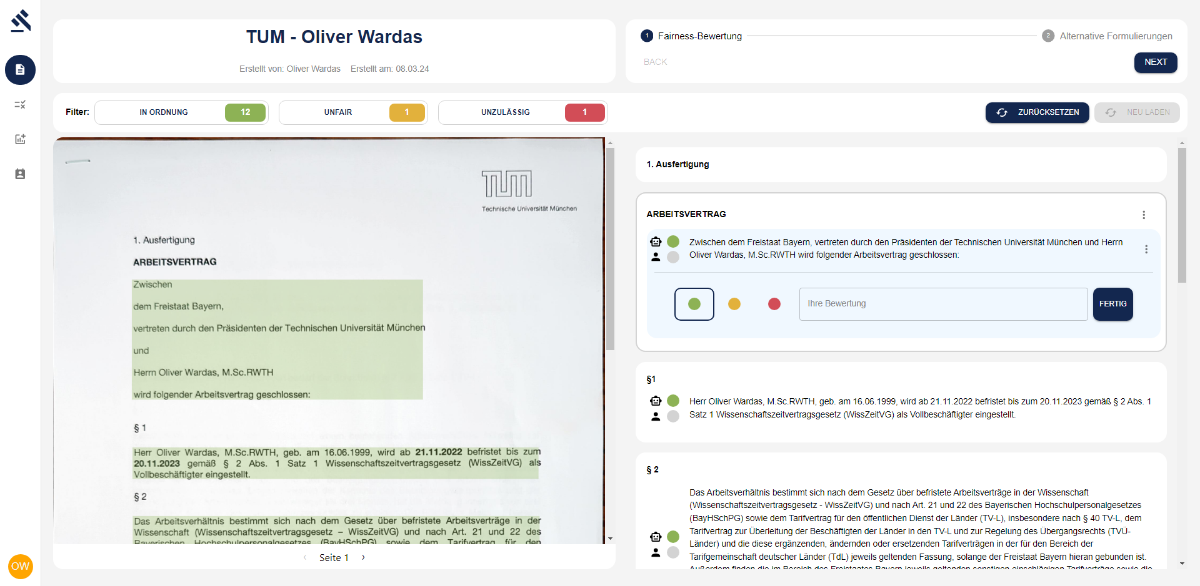
Background & Motivation
KIBeKodA: Software
Notes:
Employers sending employment contracts to the law firm to let them check if the contract is correct
Lawyers which use software can upload a pdf-version of the contract
AI recognizes clauses and mark them in 3 colors
Human in the loop AI → Lawyer is able to give the clauses his own color
f.e. if the AI highlight a clause in green, the lawyer can still say that the wording is not fair → mark it yellow
Main part of the project
Afterwards the lawyer is able to select alternative clauses from a predefined set of clauses to replace yellow or red parts

Slide 7
Outline
Background & Motivation
Research Questions
Methodology
Initial Findings
Timeline

Slide 8
Research Questions
Main Research Question:
What are the effects, incentives and barriers of adopting AI in a German law firm? – A Case Study
RQ1
What are effects, incentives and barriers to adopting AI in the legal domain?
RQ2
What are the incentives and barriers to adopting an AI-Contract-Analysis software in a German law firm?
RQ3
How does the adoption of an AI-Contract-Analysis software in a German law firm affect the existing workflows and what are contributing factors for costs and benefits?
RQ4
What are the largest drivers for costs and benefits and what are remaining challenges? (lessons learned)

Slide 9
Outline
Background & Motivation
Research Questions
Methodology
Initial Findings
Timeline

Slide 10
Methodology
Literature Review
Semi-structured Interviews
Small scaled experiment
Contract test set
Articles identified trough Google Scholar searches (n=7.338.172)
Create Guideline
Analysis with Software
Analysis without Software
Articles sreened by title (n=119)
Conduct interviews
Articles sreened by abstract (n=46)
Transcript interviews
time
Relevant articles identified (n=16)
Analyse results
workflow
results
Case Study
Notes:
In the frame of my case study I already started with my Literature research
Started by identifiing articles by using google scholar searches

Slide 11
Outline
Background & Motivation
Research Questions
Methodology
Initial Findings
Timeline
Notes:
Initial Findings sind bisher noch nicht auf Case Study bezogen

Slide 12
Initial Findings
RQ1: What are effects, incentives and barriers to adopting AI in the legal domain?
Barriers
Incentives
Hourly billing model → attorneys are not interested in increasing efficiency [4]
Skepticism towards AI [4]
Fear of job replacement by AI [5]
Many lawyers are reluctant to change [6]
Changed customer expectations ( „More-for-Less“)
Pressure to stay competitive [7]
[6]
Notes:
One challenge is that many law firms uses a hourly billing model
→ In this model Legal workers get paid by needed hour for a legal service
f.e. in our case, if the lawyer needs 3h to analyse a contract, he gets paid for 3 hours
If he only needs 1 hour for the same contract, he earns less money (the money for 1 hour)
Lawyers stick to their old processes and behaviors
Incentives:
Customers demand more service for less money
Increasing number of legal tech startups providing more work for less money, therefore to stay competitive, traditional legal firms have to adapt

Slide 13
Initial Findings
RQ1: What are effects, incentives and barriers to adopting AI in the legal domain?
Benefits
Disadvantages
Time-savings → cost-savings
→ rising productivity
Faster service delivery & better quality of service
→ increasing client satisfaction [6]
Lawyers can focus on more sophisticated and challenging work
→ increasing employee satisfaction [7]
Home office possible → more flexible
→ better work-life-balance
→ benefitial for those who provides care work [7]
Cost-/time-intensive implementation [5]
Blending of professional & personal life [7]
Insufficient critical questioning of AI suggestions [5]
„LegalTech in a law firm should be a motivation to take the quality of our services to the next level, but not an excuse for future laziness.”
[8] Kurowska, I. & Szpyt, K. (2021)
Notes:
Moreover, lawyers can focus on more … work, because the routine work is automated
Home office → more flexible → more pleasant to integrate private and professional life
Care work like taking care of children
Since mostly women provide care work it is especially for them a improvement
Disadvantages:
Job and personal life blends in → employees feels pressure to work all the time which might decrease work-life-balance

Slide 14
Outline
Background & Motivation
Research Questions
Methodology
Initial Findings
Timeline

Slide 15
Timeline
 | April | May | June | July | August | September
Literature Research
Prepare Interview Guideline & experiment
Conduct Interviews/experiment
Analyze results
Writing Thesis
Proof-Reading
Registration
Today
Hand-In

Slide 16
Prof. Dr.
Florian Matthes
17132
matthes@in.tum.de

Slide 17
Sources
[1] Gartner, “Legal Technology Trends and Predictions,” Gartner, May 03, 2021. https://www.gartner.com/en/legal-compliance/trends/legal-tech-trends
[2] K. Zhukovina, “Legal Tech Overview: Best legal tech companies and trends,” Ascendix Tech, May 18, 2023. https://ascendixtech.com/legal-tech-overview-best-legal-tech-companies/
[3] Gartner, “AI in the Legal Industry Boost your legal team’s productivity with Generative AI,” Gartner, Apr. 15, 2024. https://www.gartner.com/en/legal-compliance/trends/ai-in-legal-industry
[4] M. Kauffman and M. N. Soares, “AI in legal services: new trends in AI-enabled legal services,” Service-oriented Computing and Applications, vol. 14, no. 4, pp. 223–226, Oct. 2020,doi: 10.1007/s11761-020-00305-x
[5] C. N. Advocate, “In the Era of Artificial Intelligence (AI): Analyzing the Transformative Role of Technology in the Legal Arena,” Social Science Research Network, Jan. 2024, doi: 10.2139/ssrn.4677039
[6] T. Zalewski, “Basic principles for the effective use of legal tech tools,” in Nomos Verlagsgesellschaft mbH & Co. KG eBooks, 2021, pp. 315–332. doi: 10.5771/9783748922834-315.
[7] K. Munisami, “Legal technology and the future of women in law,” Windsor Yearbook of Access to Justice/ Recueil annuel de Windsor d'accès à la justice, vol. 36, pp. 164–183, Sep. 2020, doi: 10.22329/wyaj.v36i0.6418.
[8] I. Kurowska and K. Szpyt, “LegalTech in law firms and the work of in-house lawyers,” in Nomos Verlagsgesellschaft mbH & Co. KG eBooks, 2021, pp. 179–194. doi: 10.5771/9783748922834-179.

Slide 18
Prof. Dr.
Florian Matthes
17132
matthes@in.tum.de

